Slide 1
Book Recommendation System
Unlocking Literary Treasures: Building a Book Recommendation System

Slide 2
Table of contents
Introduction
Dataset collection, cleaning, and pre-processing
How our system works?
Visualisations
Limitations
Demo Video
The End

Slide 3
INTRODUCTION

Slide 4
PROJECT DESCRIPTION
Our project leverages Natural Language Processing (NLP) to analyze book review data based on a specific genre and user-provided keywords. The primary goal is to extract key concepts and themes from the reviews to generate a comprehensive summary and provide tailored book recommendations.

Slide 5
TEAM MEMBERS
Srivatsala K A - Backend developer (handled database interactions and interactions with API)
Wing Hang - Data Visualisation (Used the data from the NLP to create visualisations)
Swarna - Frontend Developer (Oversaw the user interface), handled NLP in sentiment analysis
Eva - Project Manager (Organised meetings and the project timeline), handled NLP in topic modelling

Slide 6
GOALS AND OBJECTIVES
1. Enhance User Experience: Improve the way users discover and select books by providing personalized and relevant recommendations.
2. Leverage NLP for Insights: Utilize advanced Natural Language Processing techniques to extract meaningful insights from book reviews.
3. Promote Reading: Encourage more reading by making it easier for users to find books that match their interests and preferences.

Slide 7
REQUIREMENTS
API : The system must use an API like Google Books API or Kaggle API to fetch reviews for a data frame which can then be analysed.
NLP Tools: Implementation of NLP libraries like NLTK to analyze text from reviews.
Data Storage: A method of storing data which is easy to access and update using CSV files.
User Interface (UI): A web-based or desktop interface to select genres and input keywords and receive recommendations.
Recommendation System: An algorithm to match user inputs with analysis data to select recommendations.

Slide 8
LIBRARIES AND TOOLS USED
• pandas for data manipulation
• numpy for numerical operations
• scikit-learn for machine learning algorithms
• matplotlib, wordcloud and seaborn for data visualization
• nltk for natural language processing
• pytest for running tests
• streamlit for user interface

Slide 9
DATASETS COLLECTION, CLEANING AND PRE-PROCESSING

Slide 10
DATASETS
Data collection :
We used kaggle API and google books API for dataset collection. Api key was set and the datasets were downloaded.
Data cleaning and preprocessing:
Unnecessary columns were dropped and spaces in text and inconsistency were modified. Lastly, column titles were changed to the same format and missing values were handled.
The text data (Review text) was pre-processed by removing stop words, punctuation, and performing tokenization.

Slide 11
HOW OUR SYSTEM WORKS?

Slide 12
INSIDE THE RECOMMENDATION ENGINE
Genre Filter:
Preprocesses text (removing stopwords, punctuation, converting to lowercase).
Cleans and categorizes book reviews into predefined genres in multiple CSV files (Because the original data is too large)
NLTK library aids in text processing.

Slide 13
Topic Modeling:
Topic modeling is an unsupervised machine learning method that analyzes large volumes of text data to identify patterns and group words into topics.
Performs topic modeling on a set of reviews to identify and summarize the main topics discussed.
function extracts and displays the top words for each topic

Slide 14
Sentiment Analysis:
Analyzes review sentiments using VADER (Valence Aware Dictionary and sEntiment Reasoner).
Provides insights into readers emotional responses by calculating compound score (-1 to 1)
Analysis Summary:
Recommends books based on user-defined keywords and genre.
Combines review scores and sentiment for personalized recommendations.
Top 10 personalized book recommendations
App:
Web app for personalized book suggestions.
Empowers users to explore genres and find their ideal reads.

Slide 15
Visualisations

Slide 16
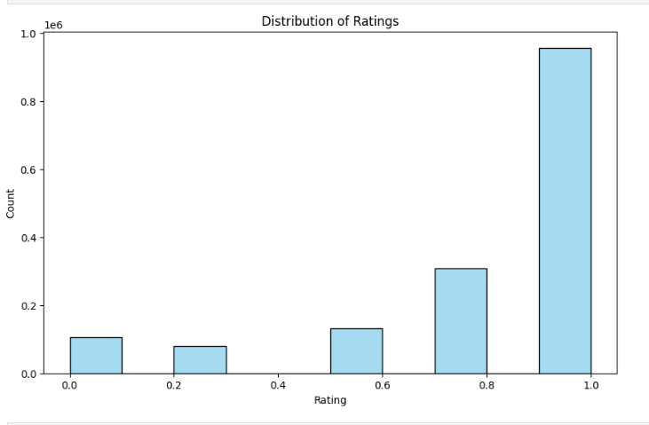

Slide 17
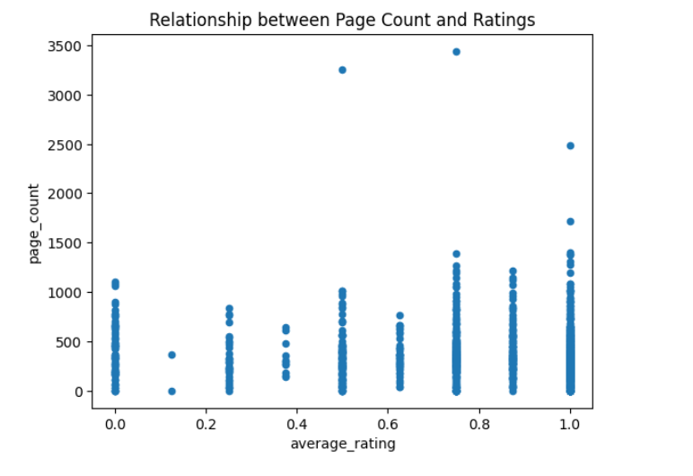

Slide 18
EVALUATIONS BASED ON VISUALISATIONS
Ratings are mostly positive. There doesn’t seem to be a significant relationship between book length and ratings. In other words, longer books aren’t necessarily rated more positively or negatively.

Slide 19
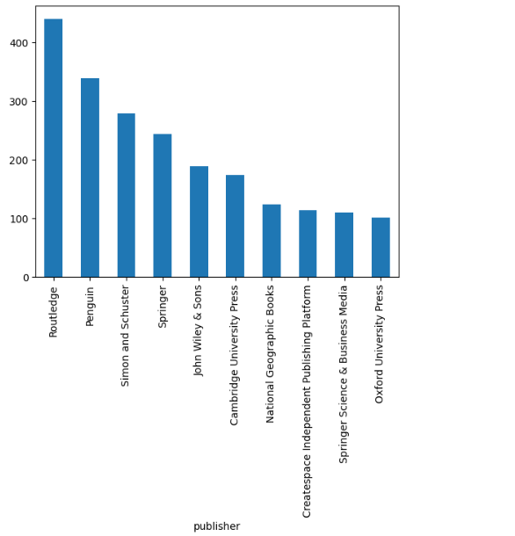

Slide 20
Routledge received the highest number of positive ratings. This could be because they have a larger volume of books reviewed by Amazon customers.

Slide 21
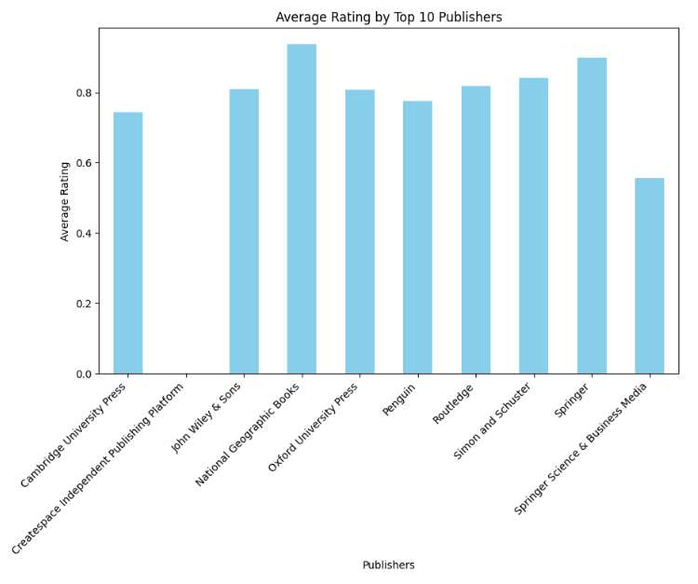

Slide 22
National Geographic, on the other hand, had the highest average rating. This suggests that their books, although fewer in number, tend to receive very positive reviews.

Slide 23
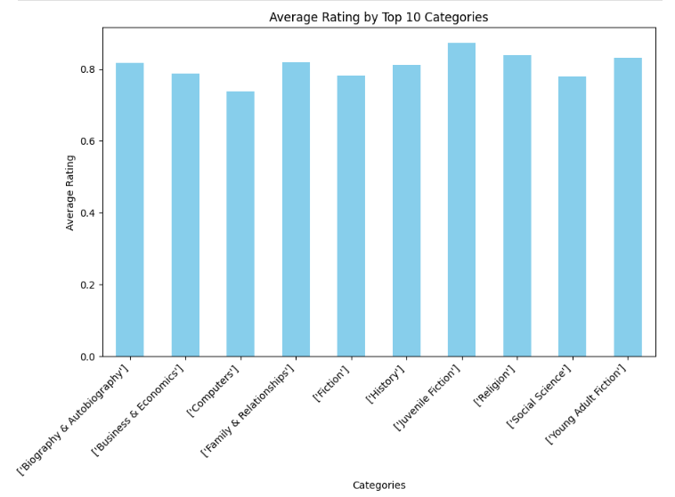

Slide 24
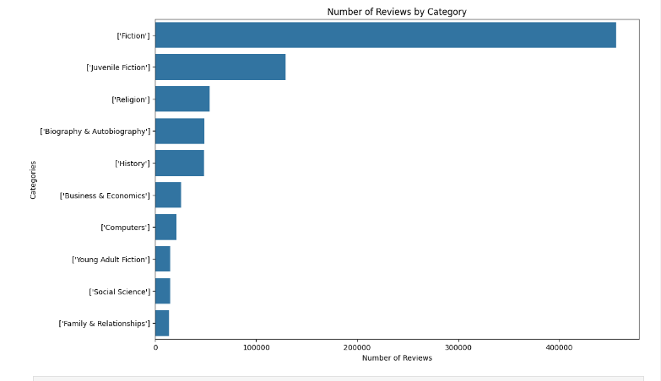

Slide 25
Juvenile Fiction books received the highest average ratings. Readers seem to appreciate this genre.

Slide 26
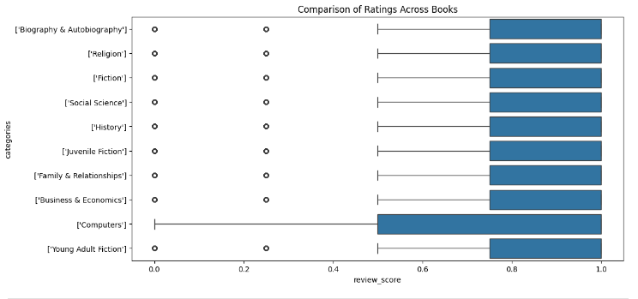

Slide 27
The box shows the interquartile range (IQR) of the data, which contains the middle 50% of the review scores for that category.The line represents the median review score for that category.
The "whiskers" extending from the box show the range of the data, excluding outliers.
The 'Computers' category has a very narrow range of review scores, suggesting that the reviews in this category are very consistent or that maybe reviewers are generally consistent with their ratings.
Computers had the largest variation in ratings, meaning opinions about computer-related books are more diverse.

Slide 28
Top rated books in each category

Slide 29
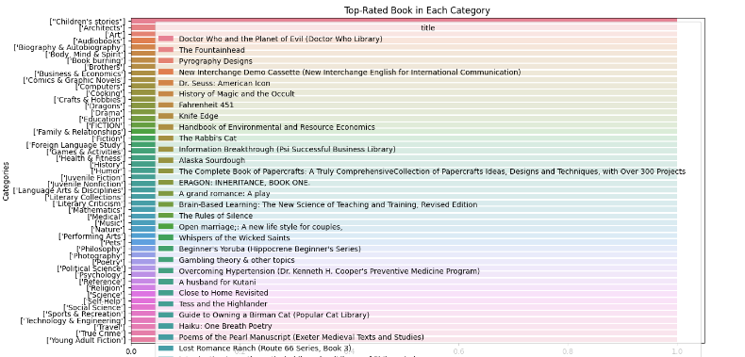

Slide 30
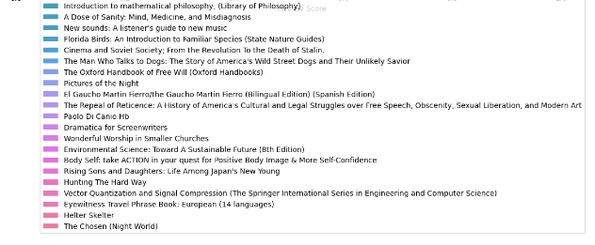

Slide 31
Most common words used in review for each category

Slide 32
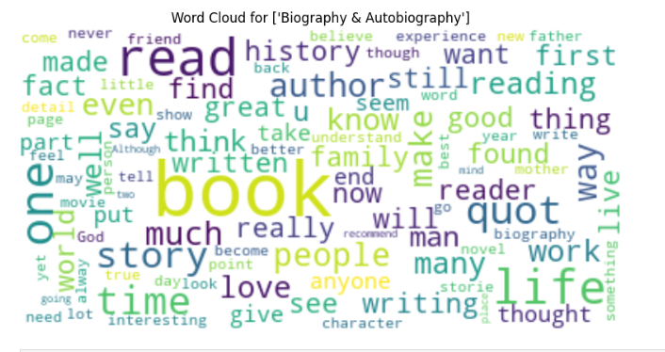

Slide 33
LIMITATIONS

Slide 34
The recommendations might be less precise and more general because of the absence of the sub-genres for each genre / category.
The system couldn’t rank books based on specific keyword density. Without this feature, the recommendations may be based on other factors, such as overall popularity or ratings.
In conclusion, by considering user reviews, the system tries to offer recommendations that resonate with individual preferences.

Slide 35
DEMO VIDEO

Slide 36
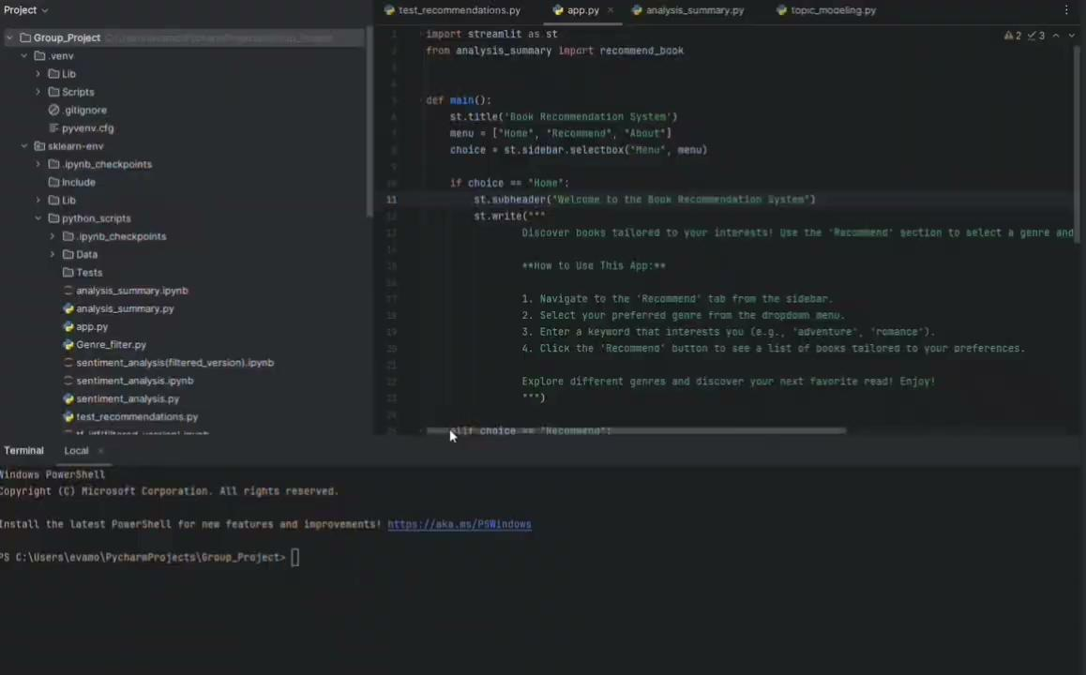

Slide 37
THANK YOU!!!

